Slide 1
eCommerce
MAK 440
Prof. Noah Federici
Notes:
1

Slide 2
Class Overview
1. The basics of business and economic motivations for electronic commerce , as well as the needs and desires of individuals.
2. The environment of information and communication that support and enable e-commerce transactions.
3. The changing role of the new , ever-present highly portable personal devices, location-based e-commerce . We will focus mainly on how e-commerce has been able to meet the needs of consumers and the evolution of this sector of the economy .

Slide 3
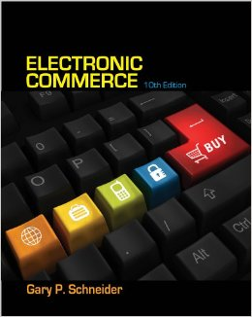
Text: E-Business, International Edition, 10th Edition; Gary Schneider

Slide 4





Notes:
Amazon's USD 74 billion sales of products and services is greater than the combined revenues of the other nine ranked companies.
Fiverr has less than 100 employees (Amazon has about 97,000)

Slide 5
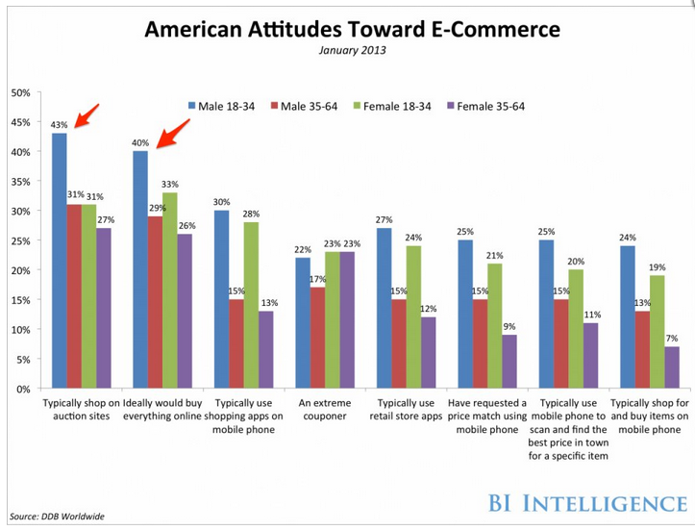

Slide 6
Overview
What electronic commerce is and how it has evolved into a second wave of growth
Why companies concentrate on revenue models and the analysis of business processes instead of business models when they undertake electronic commerce initiatives
How economic forces have created a business environment that is fostering the continued growth of electronic commerce
6

Slide 7
Overview (cont’d.)
7
How businesses use value chains and SWOT analysis to identify electronic commerce opportunities
The international nature of electronic commerce and the challenges that arise in engaging in electronic commerce on a global scale
Notes:
7

Slide 8
Electronic Commerce and Electronic Business
8
Electronic commerce
  Shopping on the Web
  Businesses trading with other businesses
  Internal company processes
  Broader term: electronic business (e-business)
Electronic commerce includes:
  All business activities using Internet technologies
    Internet and World Wide Web (Web)
    Wireless transmissions on mobile telephone networks
Dot-com (pure dot-com)
  Businesses operating only online

Slide 9
Categories of Electronic Commerce
9
Dot-com (pure dot-com)
  Businesses operating only online
Business-to-consumer (B2C)
  Consumer shopping on the Web
Business-to-business (B2B): e-procurement
  Transactions conducted between Web businesses
  Supply management (procurement) departments
    Negotiate purchase transactions with suppliers

Slide 10
Categories of Electronic Commerce (cont’d.)
Activity
  Task performed by a worker in the course of doing his or her job
  May or may not be related to a transaction
Transaction: exchange of value
  Purchase, sale, or conversion of raw materials into finished product
  Involves at least one activity

Slide 11
Categories of Electronic Commerce (cont’d.)
Business processes
  Group of logical, related, sequential activities and transactions
Web helping people work more effectively
  Telecommuting (telework)

Slide 12
Categories of Electronic Commerce (cont’d.)
Elements of electronic commerce
  Relative sizes of elements
    Rough approximation
  Dollar volume and number of transactions
    B2B much greater than B2C
  Number of transactions
    Supporting business processes greater than B2C and B2B combined

Slide 13
Categories of Electronic Commerce (cont’d.)
Consumer-to-consumer (C2C)
  Individuals buying and selling among themselves
    Web auction site
  C2C sales included in B2C category
    Seller acts as a business (for transaction purposes)
Business-to-government (B2G)
  Business transactions with government agencies
    Paying taxes, filing required reports
  B2G transactions included in B2B discussions
13

Slide 14
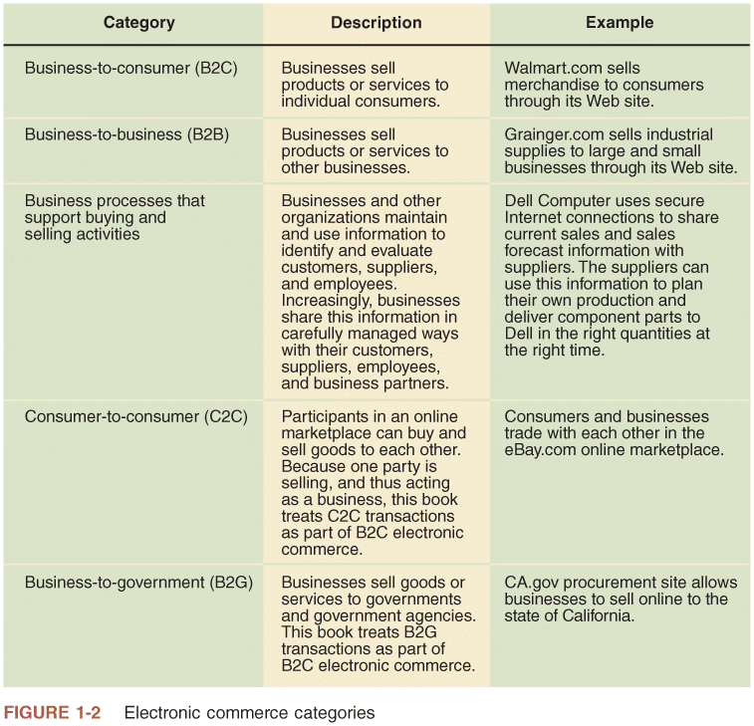
FIGURE 1-2 Electronic commerce categories

Slide 15
The Development and Growth of Electronic Commerce
15
People engaging in commerce:
  Adopt available tools and technologies
Internet
  Changed way people buy, sell, hire, and organize business activities
    More rapidly than any other technology
Electronic Funds Transfers (EFTs)
  Wire transfers
  Electronic transmissions of account exchange information
    Uses private communications networks

Slide 16
The Development and Growth of Electronic Commerce (cont’d.)
16
Electronic Data Interchange (EDI)
  Business-to-business transmission of computer-readable data in standard format
  Standard transmitting formats benefits
    Reduces errors
    Avoids printing and mailing costs
    Eliminates need to reenter data
Trading partners
  Businesses engaging in EDI with each other
  EDI pioneers (General Electric, Sears, Walmart)
    Improved purchasing processes and supplier relationships

Slide 17
The Dot-Com Boom, Bust, and Rebirth
1997 to 2000 irrational exuberance
  12,000 Internet-related businesses started
  $100 billion of investors’ money
  5,000+ companies went out of business or acquired
2000 to 2003
  $200 billion invested
  Fueled online business activity growth rebirth
  Online B2C sales growth continued more slowly
2008-2009 recession
  B2C and B2B increasing growth rates continue
  Driving force: people with Internet access increasing
  Web purchases: projected $11.9 trillion by 2013
17

Slide 18
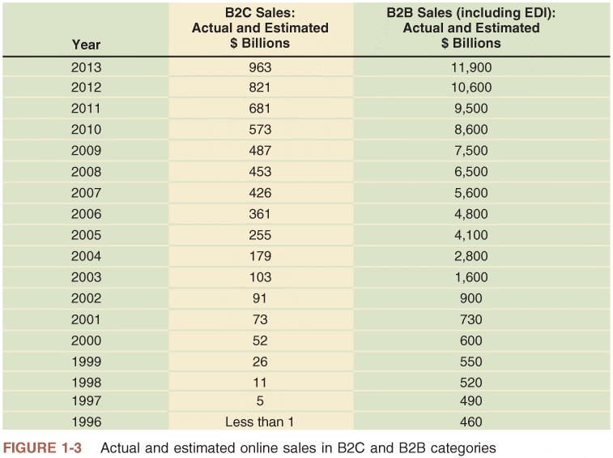
FIGURE 1-3 Actual and estimated online sales in B2C and B2B categories

Slide 19
The Second Wave of Electronic Commerce
19
Compared to four waves of Industrial Revolution
Electronic commerce first and second wave characteristics
  Regional scope
    First wave: United States phenomenon
    Second wave: international
  Start-up capital
    First wave: easy to obtain
    Second wave: companies using internal funds
  Internet technologies used
    First wave: slow and inexpensive (especially B2C)
    Second wave: broadband connections

Slide 20
The Second Wave of Electronic Commerce (cont’d.)
20
First and second wave characteristics (cont’d.)
  Electronic mail (e-mail) use
    First wave: unstructured communication
    Second wave: integral part of marketing, customer contact strategies
  Revenue source
    First wave: online advertising (failed)
    Second wave: Internet advertising (more successful)

Slide 21
The Second Wave of Electronic Commerce (cont’d.)
21
First and second wave characteristics (cont’d.)
  Digital product sales
    First wave: fraught with difficulties (music industry)
    Second wave: fulfilling available technology promise
  Business online strategy
    First wave: first-mover advantage
    Second wave: businesses not relying on first-mover advantage

Slide 22
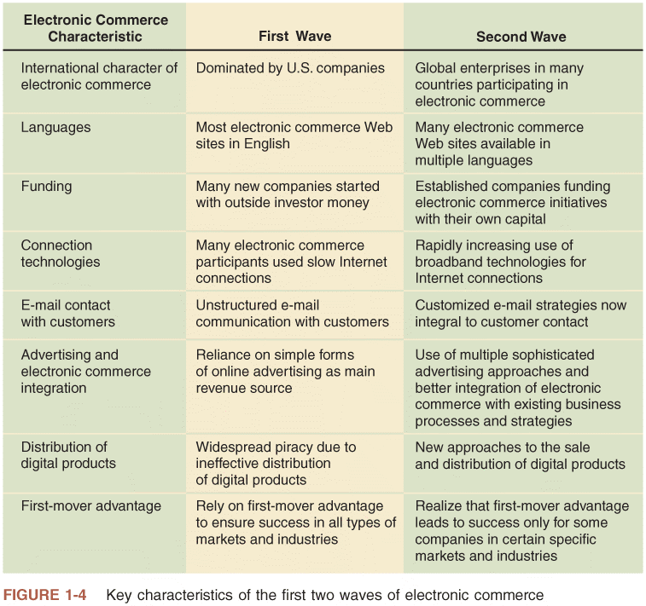
FIGURE 1-4 Key characteristics of the first two waves of electronic commerce

Slide 23
The Third Wave Begins
Accentuated by mobile telephone based commerce (mobile commerce or m-commerce)
Smart phone technology and tablet computers have made Internet available everywhere
Internet technology integration
  First wave: bar codes, scanners
  Second wave: Radio Frequency Identification (RFID) devices, smart cards, biometric technologies
  Increasing integration will lead to more effective B2B
Web 2.0: making new Web business possible

Slide 24
Business Models, Revenue Models, and Business Processes
24
Business model
  Set of processes combined to achieve company goal of yielding profit
Electronic commerce first wave
  Investors sought Internet-driven business models
    Expectations of rapid sales growth, market dominance
  Successful “dot-com” business models were emulated
    Michael Porter argued business models did not exist

Slide 25
Business Models, Revenue Models, and Business Processes (cont’d.)
25
Instead of copying model, examine business elements
  Streamline, enhance, and replace with Internet technology driven processes
Revenue model used today
  Specific collection of business processes
    Identify customers
    Market to those customers
    Generate sales
  Classify revenue-generating activities for communication and analysis purposes

Slide 26
Focus on Specific Business Processes
26
Companies think in terms of business processes
  Purchasing raw materials or goods for resale
  Converting materials and labor into finished goods
  Managing transportation and logistics
  Hiring and training employees
  Managing business finances
Identify processes benefiting from e-commerce technology
Internet technologies as a means to facilitate business processes
  Improve existing practices, identify new opportunities, adapt to change

Slide 27
Role of Merchandising
27
Merchandising
  Combination of store design, layout, and product display knowledge
Salespeople skills
  Identify customer needs
    Find products or services meeting needs
Merchandising and personal selling
  Difficult to practice remotely
Web site success
  Transfer merchandising skills to the Web
    Easier for some products than others

Slide 28
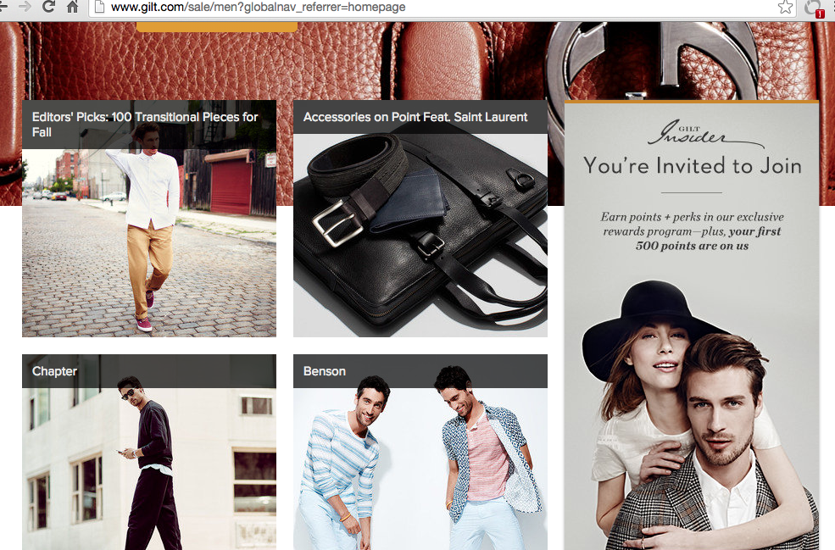
Best in Show: Merchandising

Slide 29
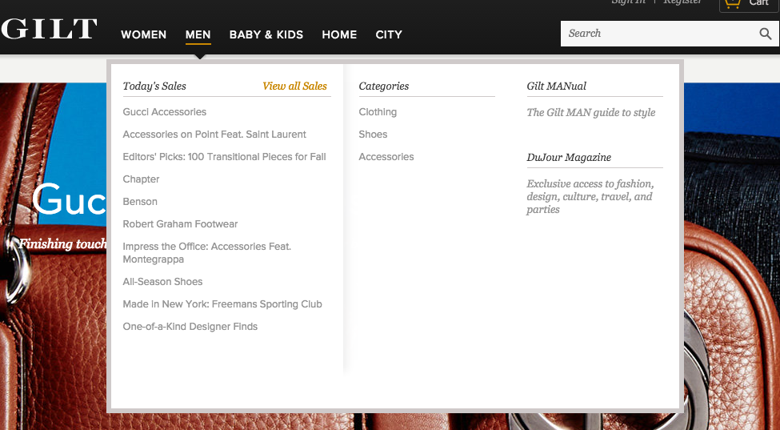
Best in Show: Merchandising

Slide 30
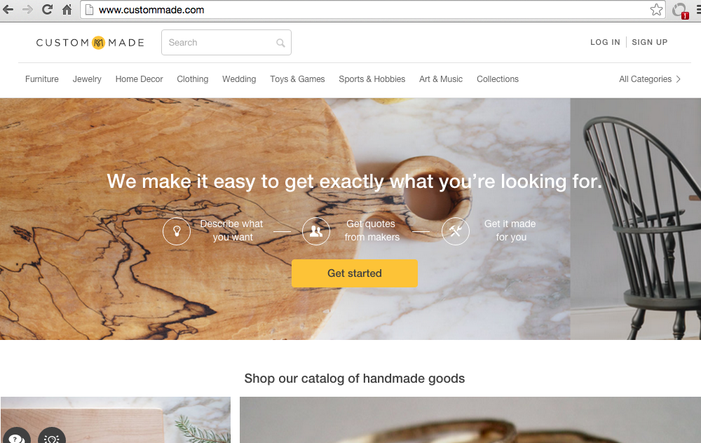
Best in Show: Merchandising

Slide 31
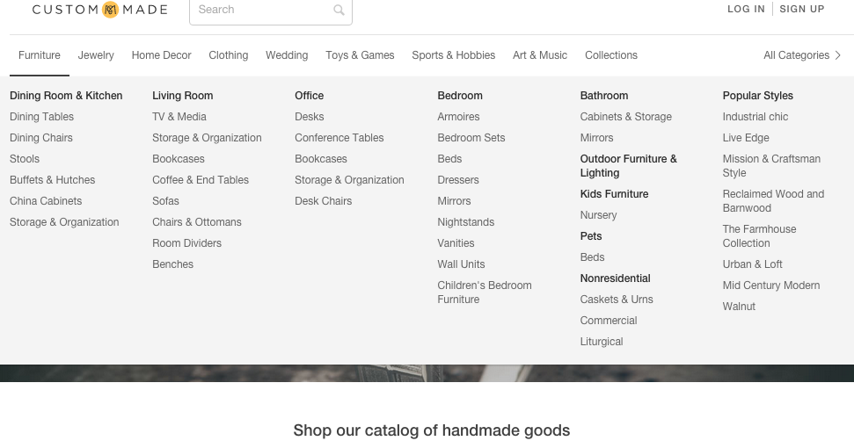
Best in Show: Merchandising

Slide 32
Product/Process Suitability to Electronic Commerce
Evaluating advantages/disadvantages of electronic commerce
Suitability is dependent on available technologies’ current state
  Change as new e-commerce tools emerge
Market Suitability???

Slide 33
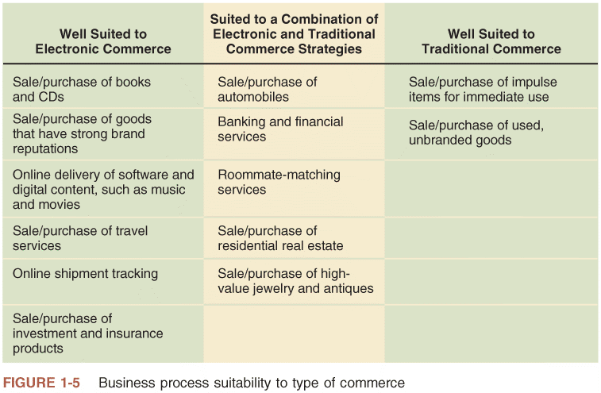
FIGURE 1-5 Business process suitability to type of commerce

Slide 34
Product/Process Suitability to Electronic Commerce (cont’d.)
34
Commodity item: well-suited to e-commerce selling
  Product or service hard to distinguish from same products or services provided by other sellers
  Features: standardized and well known
  Price: distinguishing factor
Consider product’s shipping profile
  Collection of attributes affecting how easily that product can be packaged and delivered
  Note value-to-weight ratio
    DVD: good example
    Expensive jewelry: high value-to-weight ratio

Slide 35
Product/Process Suitability to Electronic Commerce (cont’d.)
35
Easier-to-sell products have:
  Strong brand reputation
  Appeal to small but geographically diverse groups
Traditional commerce
  Better for products relying on personal selling skills
Combination of electronic and traditional commerce
  Business process includes both commodity and personal inspection items

Slide 36
Electronic Commerce: Opportunities, Cautions and Concerns
Businesses need to exercise caution in weighing risks and benefits of online business
36

Slide 37
Opportunities for Electronic Commerce
Appeal of electronic commerce is its potential to boost profits
  increases sales
  decreases costs
Virtual community: gathering of people online
  Using Web 2.0 technologies

Slide 38
Opportunities for Electronic Commerce (cont’d.)
E-commerce buyer opportunities
  Increases purchasing opportunities
  Identifies new suppliers and business partners
  Efficiently obtains competitive bid information
    Easier to negotiate price and delivery terms
  Increases speed, information exchange accuracy
  Wider range of choices available 24 hours a day
    Immediate access to prospective purchase information

Slide 39
Electronic Commerce: Cautions and Concerns
39
Poor choices for electronic commerce
  Perishable foods and high-cost, unique items
Disadvantages will disappear when:
  E-commerce matures
    Becomes more available to and accepted by general population
  Critical masses of buyers become equipped, willing to buy through Internet
    Online grocery industry example

Slide 40
Electronic Commerce: Cautions and Concerns (cont’d.)
40
Predictability of Costs and Revenues: inherent problems
  Calculating return on investment
  Recruiting and retaining employees
Technology Integration Issues
  Difficulty melding standard processes with online systems
  Uncertain outcome when integrating systems

Slide 41
Electronic Commerce: Cautions and Concerns (cont’d.)
Cultural and legal concerns
  Consumers resistant to change
  Cultural differences: security, privacy, and payments
  Ambiguous and conflicting laws

Slide 42
Using Electronic Commerce to Reduce Transaction Costs
42
Electronic commerce
  Change vertical integration attractiveness
  Change transaction costs’ level and nature
Example: employment transaction
  Telecommuting
    May reduce or eliminate transaction costs

Slide 43
Network Economic Structures
43
Neither market nor hierarchy
Strategic alliances (strategic partnerships)
  Coordinate strategies, resources, skill sets
  Form long-term, stable relationships with other companies and individuals
    Based on shared purposes
Strategic partners
  Come together for specific project or activity
  Form many intercompany teams
    Undertake variety of ongoing activities

Slide 44
Network Economic Structures (cont’d.)
44
Network organizations
  Well suited to information-intensive technology industries
  Sweater example
    Knitters organize into networks of smaller organizations
    Specialize in styles or designs
  Electronic commerce makes such networks easier to construct and maintain
    Will be predominant in the near future
  Manuel Castells predicts economic networks will become the organizing structure for all social interactions

Slide 45
Network Effects
Activities yield less value as consumption amount increases
  Law of diminishing returns
The law of diminishing returns states that in all productive processes, adding more of one factor of production, while holding all others constant ("ceteris paribus"), will at some point yield lower incremental per-unit returns. The law of diminishing returns does not imply that adding more of a factor will decrease the total production, a condition known as negative returns, though in fact this is common
Network effect
  Exception to law of diminishing returns
    More people or organizations participate in network
    Value of network to each participant increases
  Examples: Landline and mobile phones
45

Slide 46

Network Effects (cont’d.)
In January 2015, WhatsApp was the most globally popular messaging app with more than 600 million active users.[4] In April 2015, WhatsApp reached 800 million active users.[5]
WhatsApp Inc., based in Mountain View, California, was acquired by Facebook on February 19, 2014, for approximately US$16 billion.
According to Snapchat in May 2014, the app's users were sending 700 million photos and videos per day, while Snapchat Stories content was being viewed 500 million times per day. The company has a valuation of $10–$20 billion depending on multiple sources.
Pandora Internet Radio (also known as Pandora Radio or simply Pandora) is a music streaming and automated music recommendation service powered by the Music Genome Project

Slide 47
Network Effects (cont’d.)
47
E-mail account example
  Provides access to network of people with e-mail accounts
  If e-mail account is part of smaller network
    E-mail generally less valuable
Internet e-mail accounts
  Far more valuable than single-organization e-mail
    Due to network effect
Need way to identify business processes
  Evaluate electronic commerce suitability
    For each process

Slide 48
Identifying Electronic Commerce Opportunities
48
Focus on specific business processes
Break business down
  Series of value-adding activities
    Combine to generate profits, meet firm’s goal
Commerce conducted by firms of all sizes
Firm
  Multiple business units owned by a common set of shareholders or company
Industry
  Multiple firms selling similar products to similar customers

Slide 49
Strategic Business Unit Value Chains
Value chain
  Organizing strategic business unit activities to design, produce, promote, market, deliver, and support the products or services
  Michael Porter includes supporting activities
    Human resource management and purchasing
Strategic business unit primary activities
  Identify customers, design, purchase materials and supplies, manufacture product or create service, market and sell, deliver, provide after-sale service and support

Slide 50
Strategic Business Unit Value Chains (cont’d.)
Strategic business unit primary activities (cont’d.)
  Importance depends on:
    Product or service business unit provides
    Customers
Central corporate organization support activities
  Finance and administration
  Human resource
  Technology development

Slide 51
Industry Value Chains
Examine where strategic business unit fits within industry
Porter’s value system
  Describes larger activities stream into which particular business unit’s value chain is embedded
  Industry value chain refers to value systems
Delivery of product to customer
  Use as purchased materials in its value chain
Awareness of businesses value chain activities
  Allows identification of new opportunities
  Useful way to think about general business strategy

Slide 52
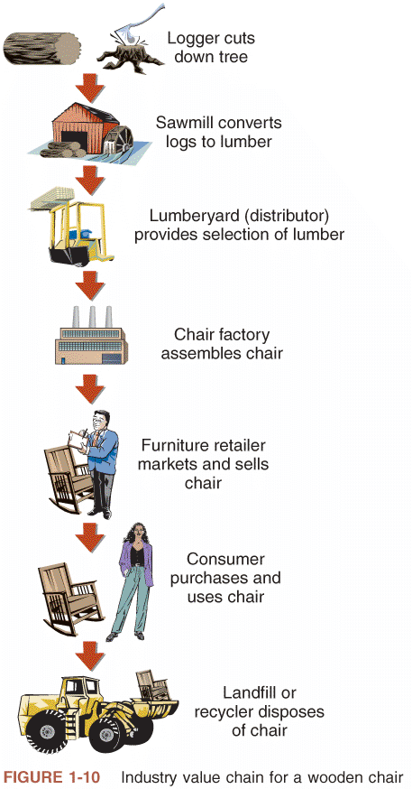
FIGURE 1-10 Industry value chain
for a strategic business unit

Slide 53
Thrillist Media Group is a digital media company consisting of three brands: food, drink and travel property Thrillist; technology and lifestyle site Supercompressor; and fashion site JackThreads. The three brands collectively reach over 15 million monthly subscriptions.
Thrillist was founded in 2004 by college friends Ben Lerer and Adam Rich. They graduated from the University of Pennsylvania in 2003 and shortly thereafter moved to New York City. Lerer is the current CEO[1] and Rich serves as editor-in-chief.[2] Lerer and Rich sent the first Thrillist e-mail newsletter in 2005 to 600 friends. Since then, the company has grown exponentially; posting revenue north of $100 million in 2014.

Slide 54
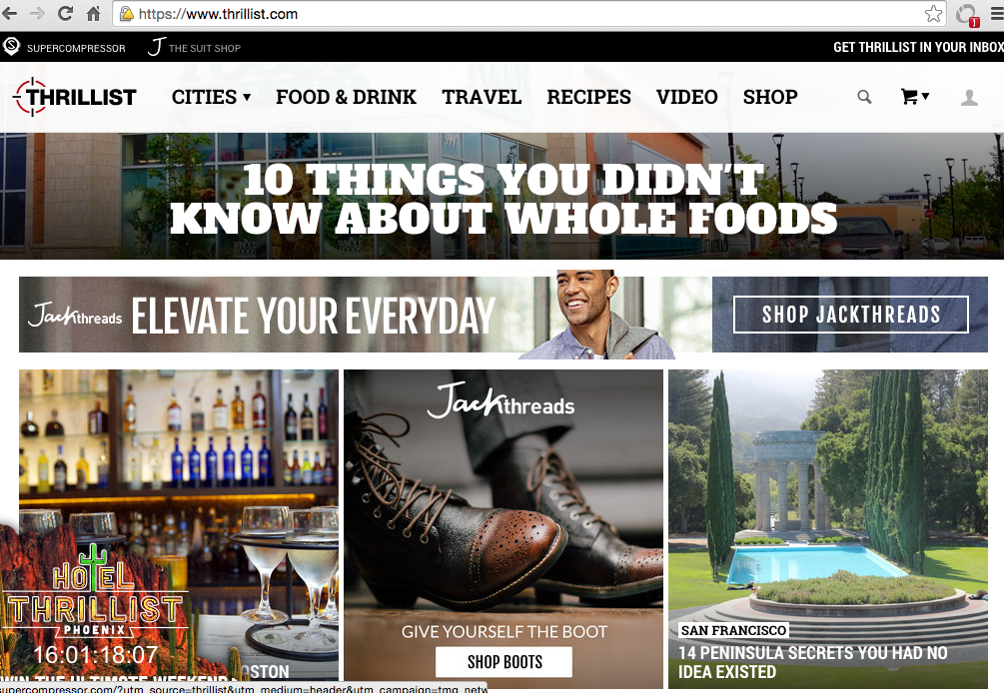

Slide 55
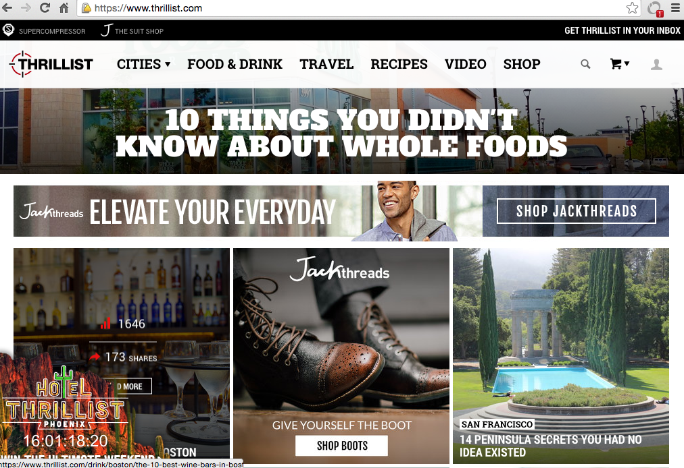

Slide 56
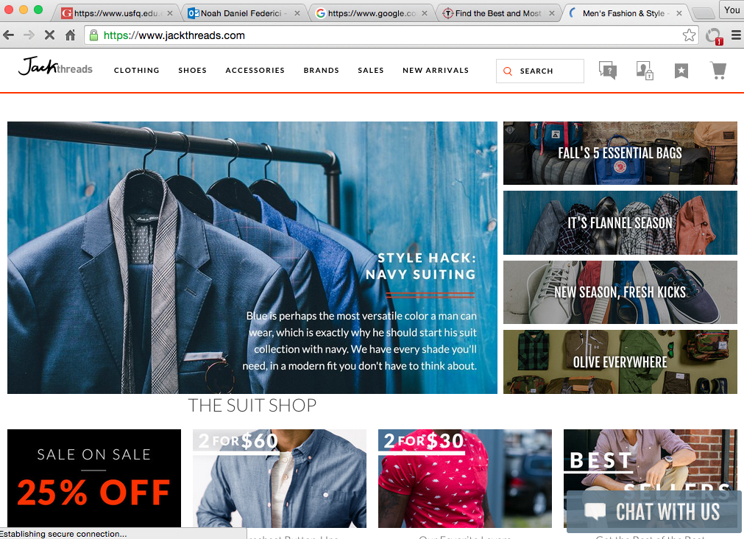

Slide 57
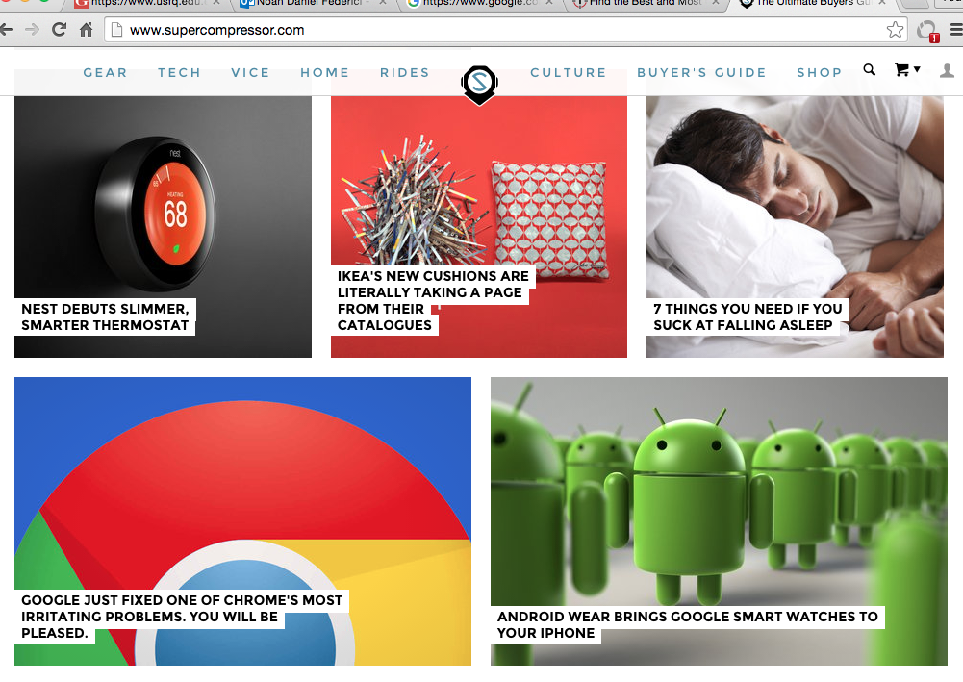

Slide 58
International Nature of Electronic Commerce
Internet connects computers worldwide
When companies use Web to improve business process:
  They automatically operate in global environment
Electronic commerce is growing in and outside the US (Refer to Figure 1-13)

Slide 59
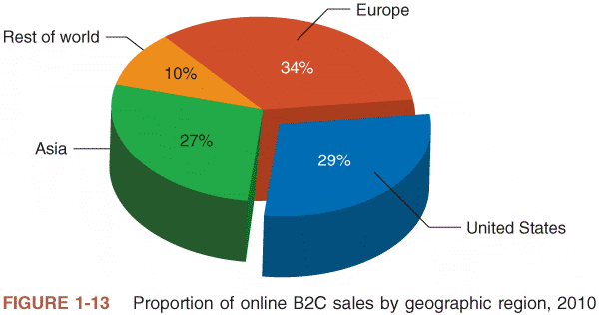
FIGURE 1-13 Proportion of online B2C sales by geographic region, 2010

Slide 60
International Nature of Electronic Commerce (cont’d.)
Key international commerce issues
  Trust
  Culture
  Language
  Government
  Infrastructure

Slide 61
Trust Issues on the Web
Important to establish trusting relationships with customers
  Rely on established brand names
Difficult for online businesses
  Anonymity exists in Web presence
  Banking example: browsing site’s pages
    Difficult to determine bank size or how well established
Business must overcome distrust in Web “strangers”

Slide 62
Language Issues
Business must adapt to local cultures
  “Think globally, act locally”
  Provide local language versions of Web site
  Customers more likely to buy from sites translated into own language
  50 percent of Internet content in English
  Half of current Internet users do not read English
    By 2015: 70% of e-commerce transaction will involve at least one party outside of the United States
Languages may require multiple translations
  Separate dialects

Slide 63
Language Issues (cont’d.)
Large site translation may be prohibitive
  Decided by corporate department responsible for page content
Mandatory translation into all supported languages
  Home page
  All first-level links to home page
High priority pages to translate
  Marketing, product information, establishing brand
Use translation services and software
  Human translation: key marketing messages
  Software: routine transaction processing functions

Slide 64
Cultural Issues
Important element of business trust
  Anticipating how the other party to a transaction will act in specific circumstances
Culture
  Combination of language and customs
  Varies across national boundaries, regions within nations
Cultural issue example
  Virtual Vineyards (now Wine.com)
Subtle language and cultural standard errors
  General Motors’ Chevrolet Nova automobile
  Baby food in jars in Africa

Slide 65
Cultural Issues (cont’d.)
Select icons carefully
  Shopping cart versus shopping baskets, trolleys
  Hand signal for “OK”: obscene gesture in Brazil
Dramatic cultural overtones
  India: inappropriate to use cow image in cartoon
  Muslim countries: offended by human arms or legs uncovered
  White color (purity versus death)
  Japan: number four is symbol of death

Slide 66
Cultural Issues (cont’d.)
Online business apprehension
  Japanese shoppers’ unwillingness to pay by credit
Softbank
  Devised a way to introduce electronic commerce to a reluctant Japanese population

Slide 67
Culture and Government
Online discussion inhospitable to cultural environments
Government controls in some cultures
  Unfettered communication not desired
  Unfettered communication not considered acceptable
    Denounced Internet material content
  Unrestricted Internet access forbidden
    Filter Web content
  Regularly reviews ISPs and their records
  Impose language requirements

Slide 68
Culture and Government (cont’d.)
Internet censorship
  Restricts electronic commerce
  Reduces online participant interest levels
China
  Wrestling with issues presented by the growth of the Internet as a vehicle for doing business
  Created complex set of registration requirements and regulations governing any business engaging in electronic commerce
  Regularly conducts reviews of ISPs and their records
Strong cultural requirements finding their way into the legal codes that govern business conduct

Slide 69
Infrastructure Issues
Internet infrastructure
  Computers and software connected to Internet
  Communications networks’ message packets travel
Infrastructure variations and inadequacies exist
Outside United States
  Government-owned industry
    Heavily regulated
  High local telephone connection costs
    Affect buying online behavior
International orders: global problem
  No process to handle order and paperwork

Slide 70
Infrastructure Issues (cont’d.)
Business face challenges posed by variations and inadequacies in the infrastructure supporting the Internet throughout the world
  Local connection costs
  Inability to handle order
Freight forwarder
  Arranges international transactions’ shipping and insurance
Customs broker
  Arranges tariff payment and compliance

Slide 71
Infrastructure Issues (cont’d.)
Bonded warehouse
  Secure location
  Holds international shipments until customs requirements or payments satisfied
Handling international transactions paperwork
  Annual cost: $800 billion
  Software automates some paperwork
    Countries have own paper-based forms, procedures
    Countries have incompatible computer systems
See Figure 1-14: complex information flows

Slide 72
Summary
Electronic commerce
  Application of new Internet and Web technologies
    Helps individuals, businesses, other organizations conduct effective business
  Adopted in waves of change
    First wave ended in 2000
    Second wave focuses on improving specific business processes
    Third wave relies on availability of mobile devices with Internet connectivity
72

Slide 73
Summary
Technology improvements
  Create new products and services
  Improved promotion, marketing, delivery of existing offerings
  Improve purchasing and supply activities
  Identify new customers
  Operate finance, administration, human resource management activities more efficiently
  Reduce transaction costs
  Create network economic effects
    Leads to greater revenue opportunities

Slide 74
Summary (cont’d.)
74
Electronic commerce
  Fits into markets, hierarchies, networks
Value chains
  Occur at business unit, industry levels
Value chains and SWOT analysis
  Tools to understand business processes
    Analyze suitability for electronic commerce implementation

Slide 75
Summary (cont’d.)
75
Key international commerce issues
  Trust
  Culture and language
  Government
  Infrastructure

